Slide 1
HELPING ADOLESCENTS COPE WITH THE IMPACT OF THE MEDIA ON THEIR BODY IMAGE & SELF ESTEEM
By Mtheto Hara
Notes:
This presentation demonstrates the new capabilities of PowerPoint and it is best viewed in Slide Show. These slides are designed to give you great ideas for the presentations you’ll create in PowerPoint 2011!
For more sample templates, click the File menu, and then click New From Template. Under Templates, click Presentations.

Slide 2
Welcome to a presentation on …
Self Esteem
Media Impact
Adolescents
Body Image
“let’s get it on …”

Slide 3
So what do we mean by MEDIA ?
“lets break it down …”

Slide 4
Media :
Television & radio
( broadcast media)
Newspapers and magazines
( print media)
Internet & World Wide Web ( electronic media)
Facebook, Twitter, Instagram etc ( social media)

Slide 5

And what is SELF ESTEEM?
“ lets look at it … “

Slide 6
SELF ESTEEM:
The value and respect that you have for yourself as a person
It is the opinion that you have about yourself inside and out
It impacts how you take care of yourself physically, emotionally, spiritually and psychologically

Slide 7
And what is BODY IMAGE?
“ lets analyze it … “

Slide 8
BODY IMAGE:
One’s attitude towards one’s body
How you see yourself
How you feel about how you look
How you think others perceive you

Slide 9
How do you know if you have a
Healthy or an Unhealthy Body Image ?

Slide 10
Healthy Body Image :
Comfortable in your own skin
Happy with the way you look
Feeling good about yourself both inside and out
You value who you are not what you look like

Slide 11
Unhealthy Body Image :
you think your body is disgusting or that you are too fat/ too thin/ not buff enough/ not sexy enough / that you are not good looking and no body loves you
You feel like the way you look determines your value as a person
You are so fixated on changing your body shape or appearance

Slide 12
And who are the ADOLESCENTS ?
“lets understand them … “

Slide 13
ADOLESCENTS :
One who is at transition stage in human development from childhood to adulthood
From 10 – 19 years of age

Slide 14
Characteristics of Adolescents:
Rapid physical growth and development – changes in voice, height, weight and strength
Sexual maturity leading to strong curiosity about sexual activities

Slide 15
More characteristics of Adolescents:
Experimentation and development of adult thought processes
Seeking independence and a unique identity

Slide 16


Group Discussion Exercise!!
Okay folks, lets get interactive now …

Slide 17
Analyze the case example below and answer the questions that follow:

Slide 18
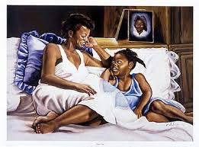
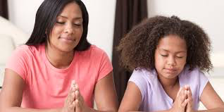
ABOUT A GIRL NAMED TIWONGE
Stage 1- Tiwonge with her mother at age 10 - still in primary school

Slide 19
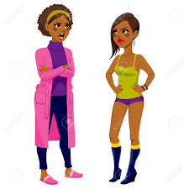
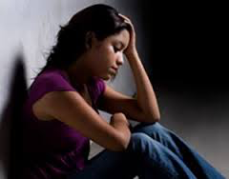
Stage 2- Tiwonge with her mother at age 14. She is in secondary school now but her mother does not want her to go out and hang out with her friends. Her mother wants her to focus on studies.
“ Girls need to work hard in school in order to be taken seriously in this world. I don’t want you to end up like those girls in the street!”

Slide 20
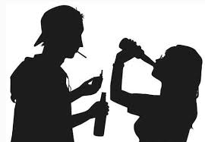
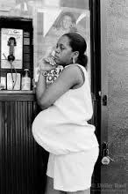
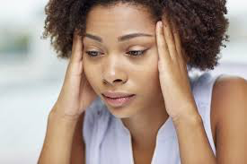
Stage 3 - Tiwonge at age 15 – wondering if she should run away from home.

Slide 21
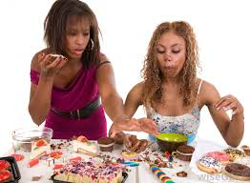
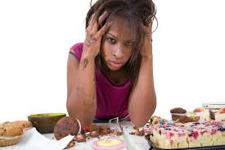

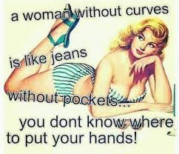
Stage 4 - Tiwonge at age 16/17 – has very few friends and finds comfort in snacks and Tv since she is at home most of the times. Her mobile phone is her best connection to the outside world.

Slide 22
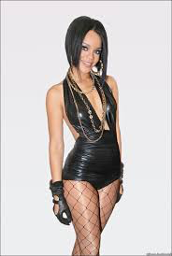
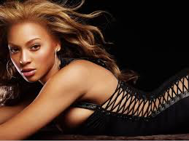
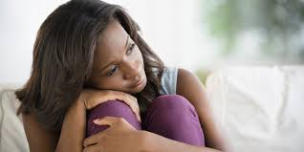
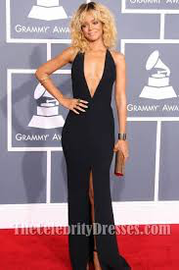
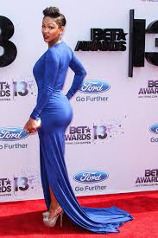
Stage 5 - Tiwonge at age 17 about to graduate high school and dreaming of being famous like her idols Beyonce, Rihanna & Megan Good

Slide 23
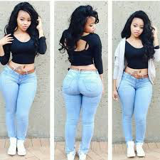

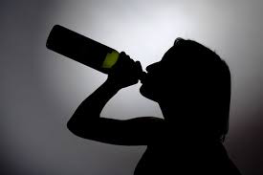
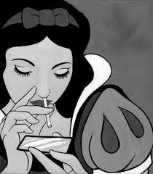
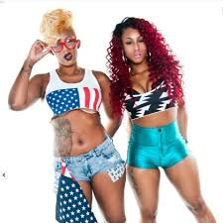
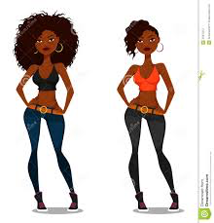
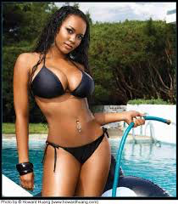
Stage 6 – Tiwonge is in University age 19 – 21 and well, she is “ famous” alright !!

Slide 24
Discuss & answer the following questions:
What kind of issues has Tiwonge gone through so far – body image issues , self esteem issues or both ?
Is she still going through these issues now that she is in college ? Give a reason to support your answer.
At which stage did these issues begin? Make an argument to support your answer.
At which stage would counseling be most effective to help Tiwonge? Explain how counseling would help Tiwonge.
If you were Tiwonge’s mother , is there anything you would have done differently or did she do the best that any mother can do?

Slide 25
Consult the handouts you have been given and respond to the above questions.
10 mins discussion and 10 mins giving feedback from your discussions.

Slide 26
Now let’s open the floor to a session on sharing & caring.
Would anyone like to share some personal stories or professional experiences dealing with self esteem or body images issues ?
15 minute session

Slide 27
Reference Links:
http://centerforparentingeducation.org/library-of-articles/riding-the-waves-of-the-teen-years/riding-the-waves-of-the-teen-years-part-ii-understanding-your-adolescent/
http://www.preservearticles.com/2011082611910/what-are-the-general-characteristics-of-adolescence-amoung-students.html
http://www.mirror-mirror.org/the-media-and-body-image.htm

Slide 28
Thank you for a wonderful discussion .
Till next time, let’s all have a healthy body image always.
The End.

